Slide 1
Integrated Culinary Services Platform
Company name: Rockg Micro Technologies
Guide name: Dr. Vijilesh V
Name: Mohamed Ibrahim Afrith .M
Roll No: 23MCA035

Slide 2
Objectives:
Streamline the operations of a food court by offering digital solutions for user interaction.
Enable users to securely sign up, log in, and access a personalized dashboard.
Deliver a unified, efficient, and enjoyable app experience to meet modern food court requirements.
Facilitate efficient navigation between app modules using a bottom navigation bar.
Lay the foundation for expanding the app with ordering, payments, and feedback modules

Slide 3
Platform Details:
Software Configuration
Frontend: Flutter (Dart), Bloc, Provider, Redux
Machine Learning: TensorFlow
Backend: Firebase Authentication (for user login and signup)
Database: Firebase Firestore
Version Control: Git/GitHub
Development Tools: Android Studio, PyCharm
Hardware Configuration
Development Machine:
Processor: Intel Core i7 12th gen
RAM: 8GB
OS: Windows
Testing Devices:
Android smartphones with Android 8.0 (Oreo) or higher

Slide 4
Existing System:
Reliance on a manual token system for ordering and pickups, which is time-consuming and prone to errors.
Limited tracking of order status, leading to confusion and delays for both customers and vendors.
Lack of digital records makes it difficult to analyze sales data or customer preferences effectively.
No direct interaction or feedback mechanism between customers and food court management.
Inefficiency in queue management, causing longer wait times and decreased customer satisfaction.

Slide 5
Proposed System:
Digitized Management: Centralized platform for real-time order tracking and seamless operations.
Secure Login: Firebase Authentication ensures secure and smooth user onboarding.
Easy Navigation: Bottom navigation bar provides quick access to key modules like Home, Orders, and Feedback.
Order Customization: Users can browse menus, customize orders, and avoid queues.
Feedback System: Enables customers to rate stalls and provide suggestions for improvement.
Data Insights: Vendors receive analytics on sales trends, peak hours, and popular items.
Cross-Platform Support: Ensures compatibility with Android, Web and iOS devices.

Slide 6
Modules:
1. Authentication Module:
Login and Sign-Up screens integrated with Firebase Authentication for secure access.
Password reset functionality and email verification included.
2. Main Tab Navigation Module:
Bottom navigation bar enabling seamless navigation between key sections: Home, Orders, Feedback, and Profile.
3. Menu Management Module:
Displays categorized menus with images, descriptions, and prices.
Option to customize and add items to the cart.

Slide 7
Modules:
4. Order Management Module:
Allows users to place, track, and manage orders in real time.
Notifications for order status updates (e.g., "Preparing," "Ready for Pickup").
5. Feedback and Rating Module:
Enables users to rate stalls and provide feedback on orders and services.
Helps vendors and administrators identify areas for improvement.
6. Settings Module:
Placeholder for user preferences like notification settings, profile management, and payment options.
7. Vendor Management Module:
Backend module for vendors to update menus, track orders, and analyze sales data.

Slide 8
Table Design:
Collection | Fields | Description
users | user_id, name, email, password, profile_image | Stores user information.
food_items | item_id, name, price, image_url, description, category | Menu items offered in the food court.
orders | order_id, user_id, items, total_price, status, timestamp | Tracks user orders and their status.
feedback | feedback_id, user_id, stall_id, rating, comments | Stores feedback and ratings from users.
vendors | vendor_id, name, stall_details, menu_items | Details about food court vendors.
analytics | analytics_id, vendor_id, sales_data, peak_hours | Provides insights on vendor performance.

Slide 9
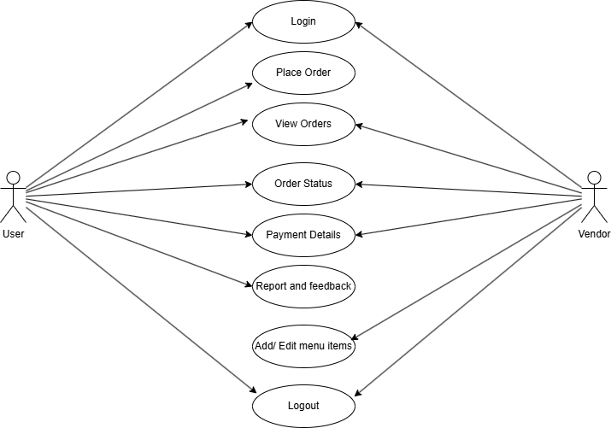
Use Case Diagram:

Slide 10
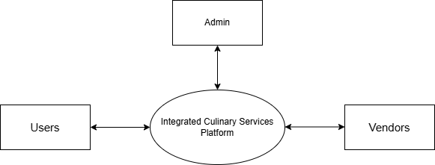
Data Flow Diagram
Level – 0

Slide 11
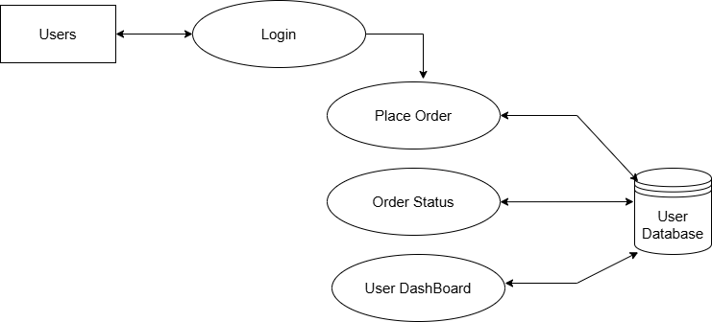
Level -1

Slide 12
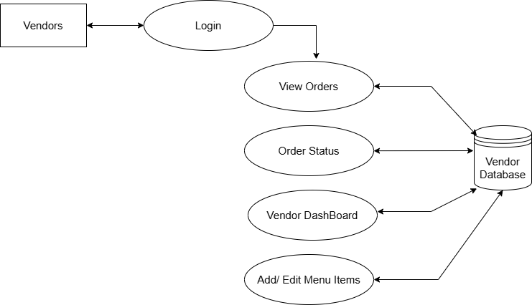
Level -1 (continue)

Slide 13
Outcomes of the Project
1. Efficient Order Management:
Users can place, track, and manage orders seamlessly through an intuitive interface.
Real-time order status updates reduce delays and enhance customer satisfaction.
2. Menu Navigation and Customization:
Organized menu categories with images, descriptions, and prices for easy exploration.
Option to customize items and add them to the cart before placing orders.
3. Centralized Vendor Management:
Vendors can update menus, monitor orders, and access sales analytics in real time.
Simplifies operational workflows for food court vendors.
4. Feedback and Rating System:
Users can provide feedback and rate food items and stalls, contributing to continuous improvement.

Slide 14
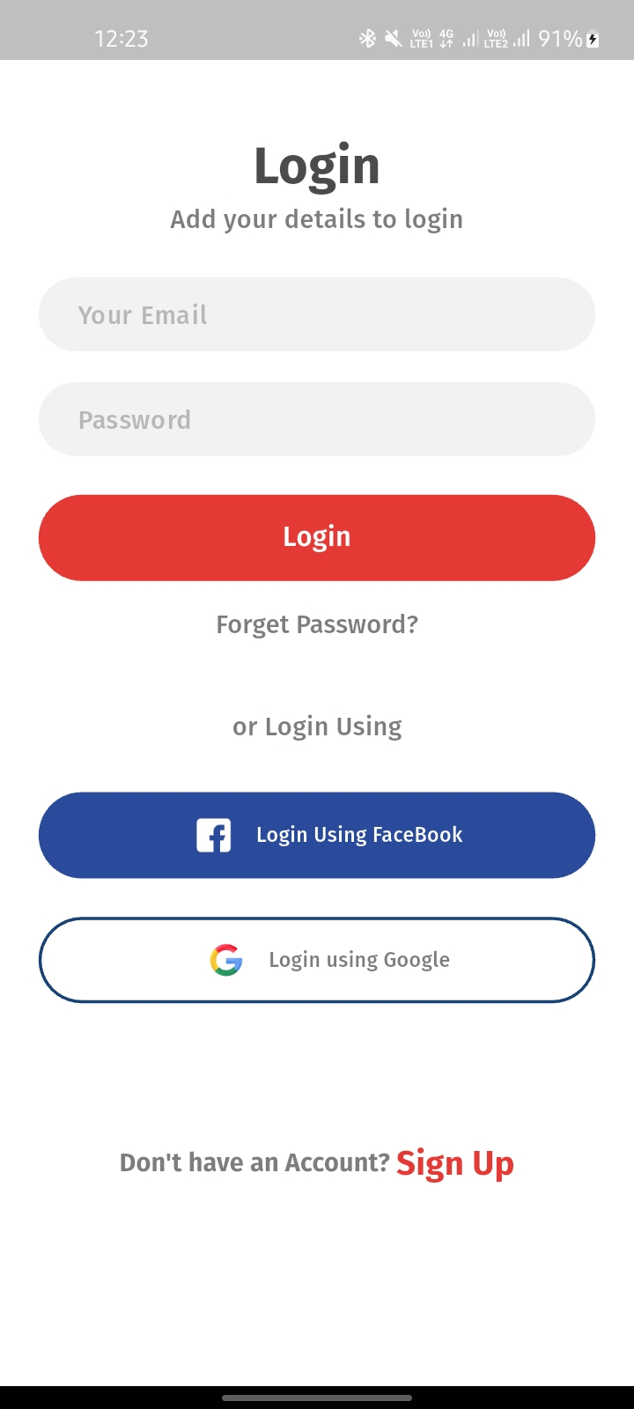
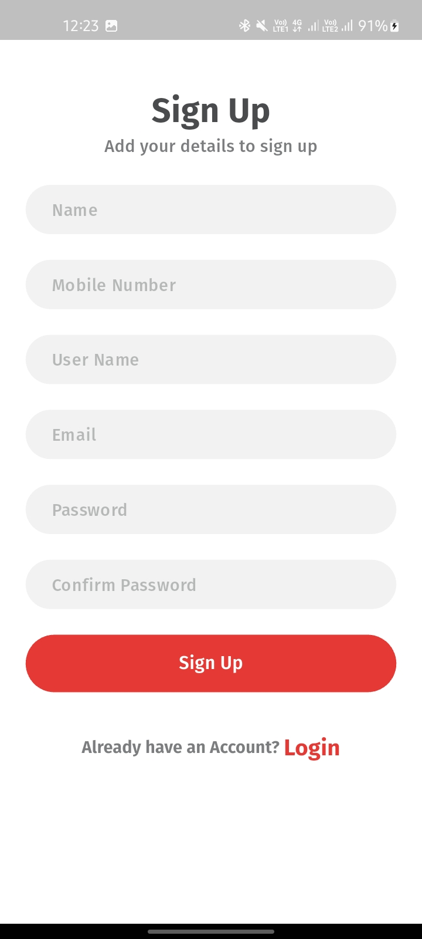
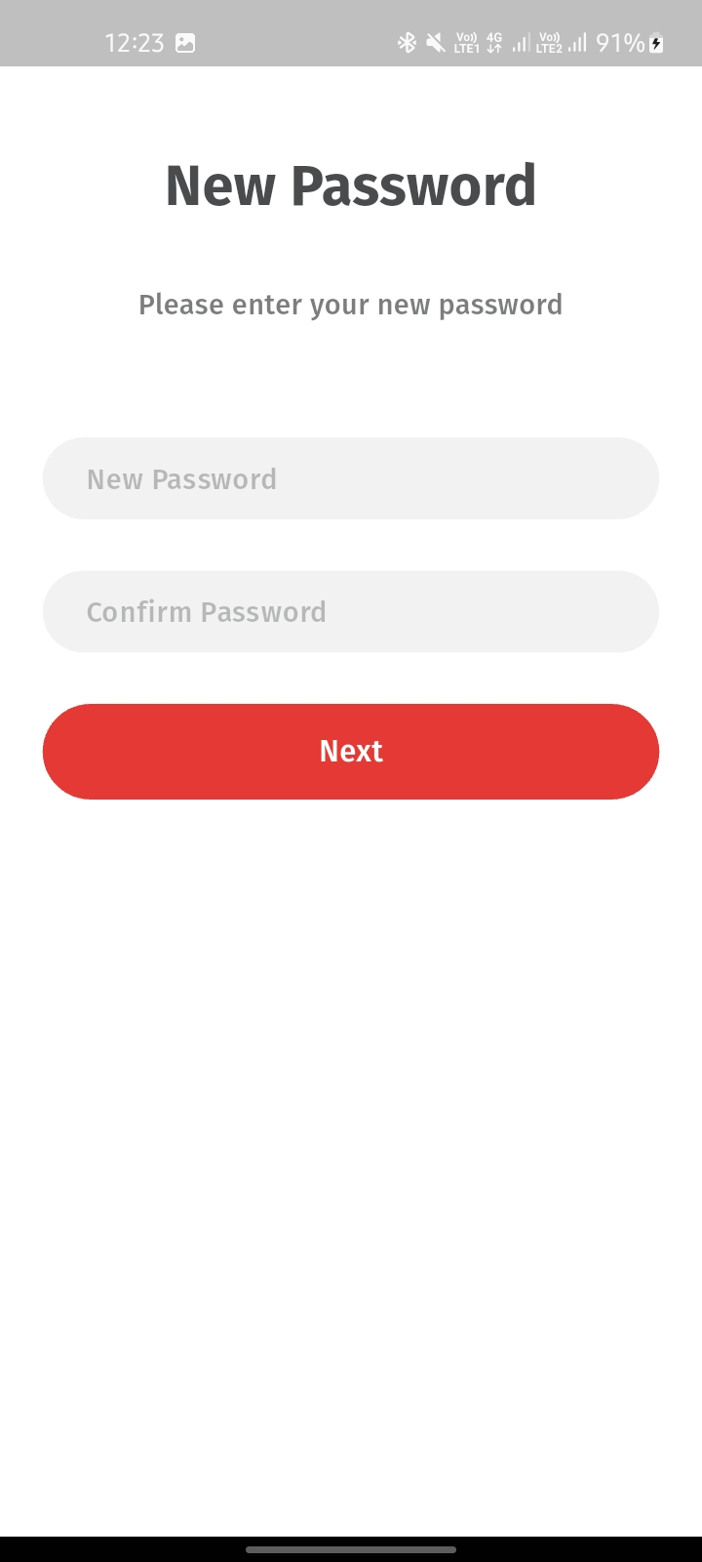

Slide 15
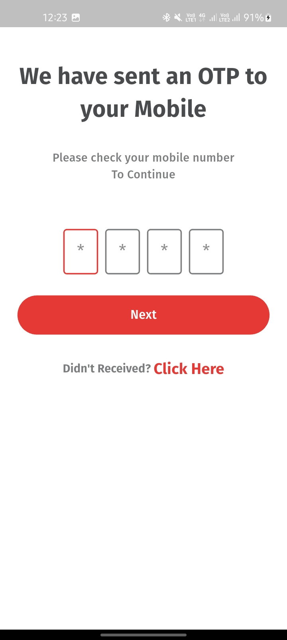
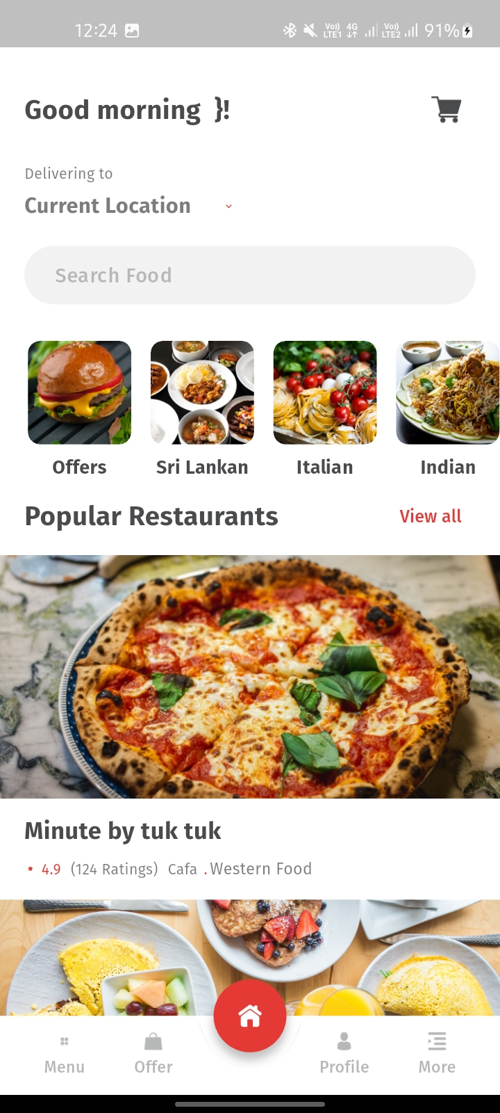
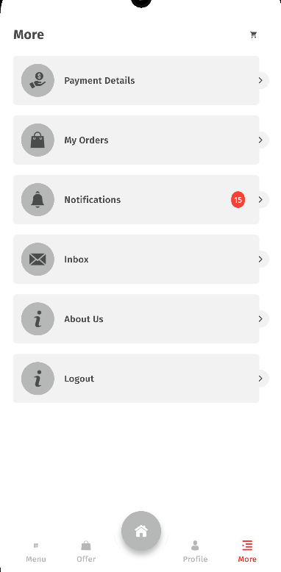

Slide 16
References:
https://firebase.google.com/docs
https://flutter.dev/docs
UI/UX inspirations from Dribbble and Behance.
https://www.udemy.com

